Slide 1
Module-III Cell division: Mitosis and Meiosis

Slide 2
Cell cycle
The cell cycle is the series of events that take place in a cell leading to its division and duplication of its genetic material (DNA) to produce 2 daughter cells
In prokaryotic cells, the cell cycle occurs via a process termed binary fission.
In eukaryotic cells, the cell cycle can be divided in two periods-
Interphase
Mitosis

Slide 3
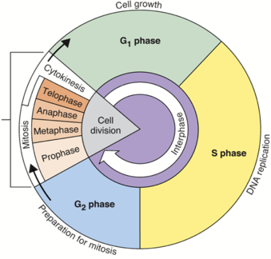
Overview
The cell cycle consists of four distinct phases:
G1 (Gap1) phase,
S phase (synthesis),
G2 (Gap2) phase (collectively known as interphase) and
M phase (mitosis)

Slide 4
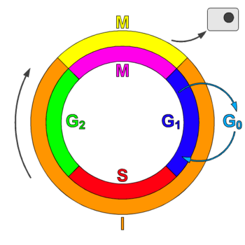
Resting Phase
Gap0 phase
The G0 phase is a period in the cell cycle in which cells exist in a quiescent state.
G0 phase is viewed as either an extended G1 phase, where the cell is neither dividing nor preparing to divide, or a distinct inactive stage that occurs outside of the cell cycle.
The cell cycle starts at this phase.

Slide 5
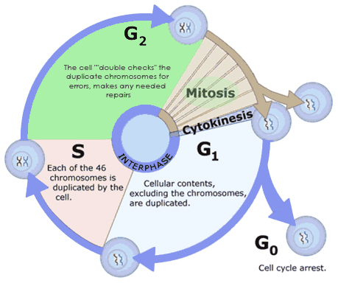
Interphase
Before entering the cell cycle, the cell needs to make preparations.
All preparations are done in interphase.
The interphase has 3 stages:
G1 phase,
S phase, and
G2 phase.

Slide 6
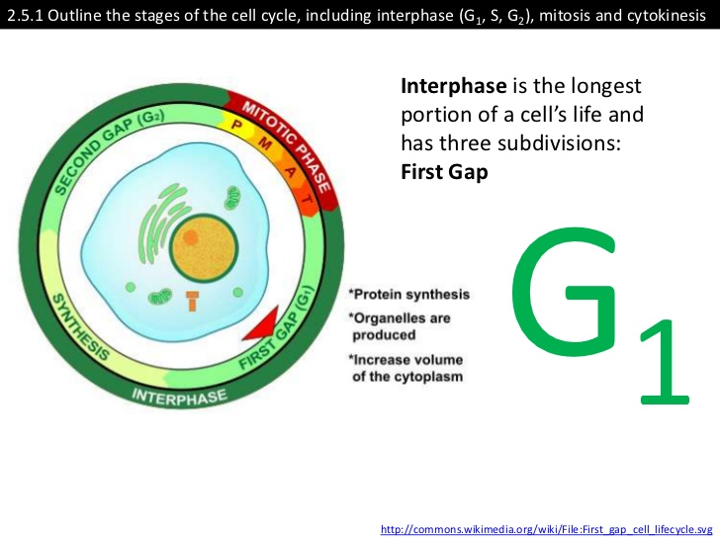
G1 Phase
It starts from the M phase of the previous cycle until the beginning of the DNA synthesis.
Also known as the growth phase.
The cells increase in size in gap1 phase
Biosynthetic activities have a high rate.
This phase is marked by synthesis of various enzymes that are required in S phase, mainly those needed for DNA replication.
Duration of G1 is highly variable, even among different cells of the same species.
In this phase, the cell increases the supply of the proteins(mitochondria, ribosomes)

Slide 7
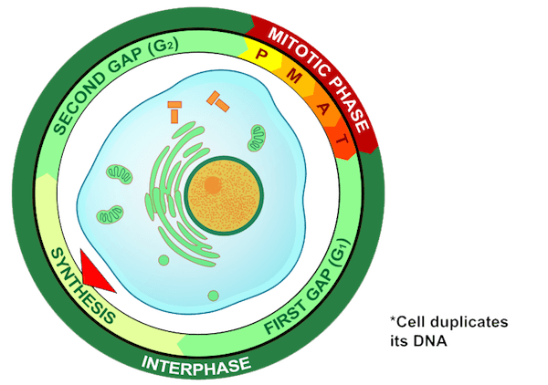
S Phase (Synthesis phase)
Initiation of DNA replication is indication of S phase.
It is completed when all of the genetic content, i.e., DNA has been replicated; at this time each chromosome has two (sister) chromatids.
Thus, during this phase, the amount of DNA in the cell effectively doubles.
Rates of RNA transcription and protein synthesis are very low during this phase.
An exception to this is production of histone protein, which mostly occurs during the S phase.

Slide 8
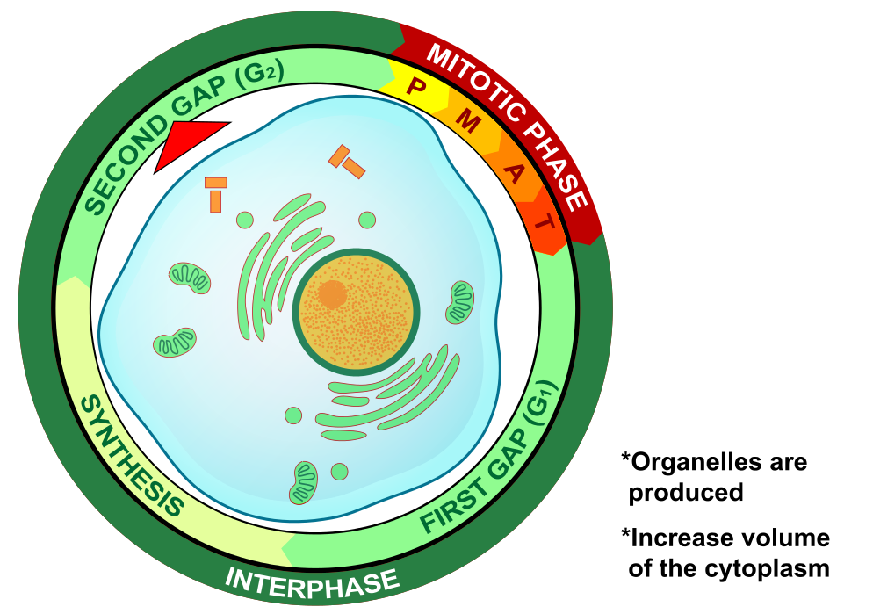
G2 Phase (Growth phase)
Period of protein synthesis and rapid cell growth as the cell now prepares for cell division.
Notes:
Growth phase
After S phase or replication cell then enters the G2 phase, which lasts until the cell enters mitosis. Again, significant biosynthesis occurs during this phase, mainly involving the production of microtubules, which are required during the process of mitosis. Inhibition of protein synthesis during G2 phase prevents the cell from undergoing mitosis.

Slide 9
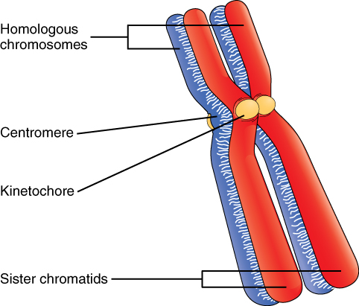
Mitosis
Cell division stops. Cellular energy is now more focused on division.
Relatively a brief period
Complex, but highly regulated.
Prophase
Metaphase
Anaphase
Telophase
During this phase, pairs of chromosomes in the cell’s nucleus condense and attach to fibers that pull the sister chromatids on the opposite side of the cell.

Slide 10
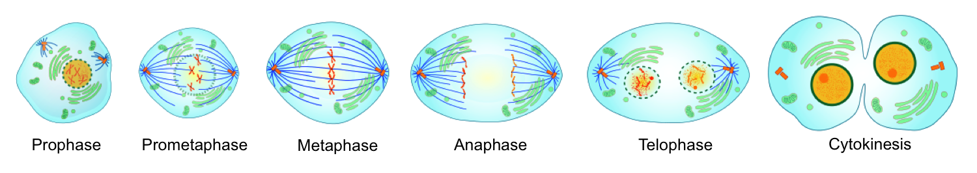
Phases of Mitosis

Slide 11
Prophase of mitosis
Mitosis begins with prophase and is identifiable by the complete condensation of the chromosomes.
When this occurs, chromosomes are visible under the microscope.
During prophase there are two exact copies of sister chromatids in each homologous chromosome.
Also during prophase the centriole pairs begin to migrate to the poles and spindle fibres emerge from the centriole pairs.
Furthermore, the nuclear envelope begins to disintegrate.

Slide 12
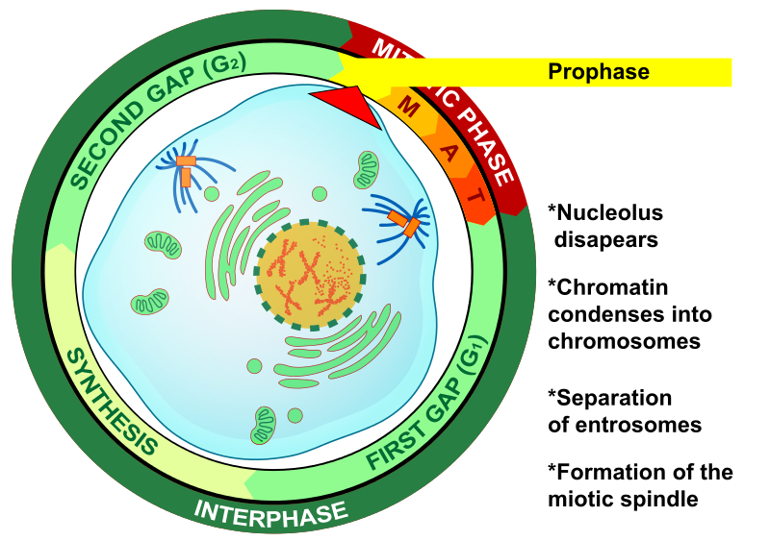
Prophase

Slide 13
Prometaphase of Mitosis
Prometaphase is a continuation of prophase.
The nuclear envelop continues to disintegrate until it is completely non-existent.
The spindle fibres continue to grow from the centriole pairs and connect to the kinetochore of the centromere region of the chromosome.
The centriole pairs continue to move toward opposite poles.

Slide 14
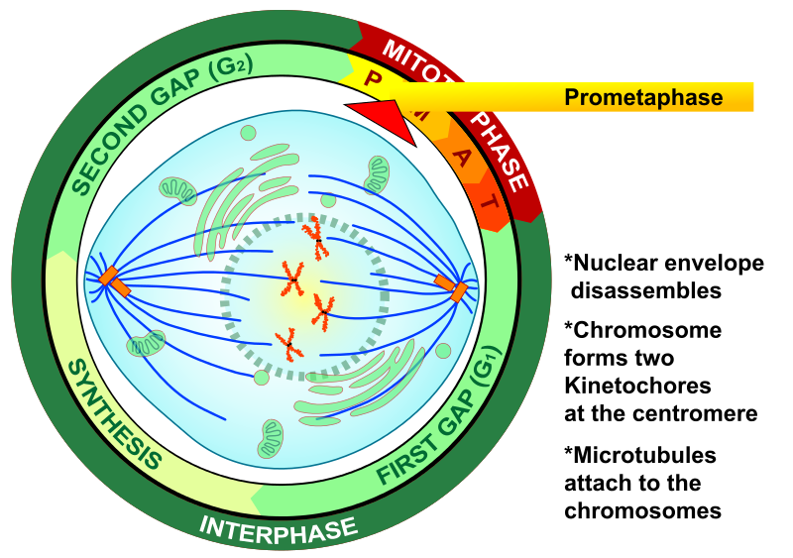
Prometaphase of Mitosis

Slide 15
Metaphase of Mitosis
Once the spindle fibres attach to the kinetochores at the centromere region of the homologous chromosomes, the centrioles begin to push the homologous chromosomes towards the centre of the cell.
The chromosomes align along the metaphase plate.

Slide 16
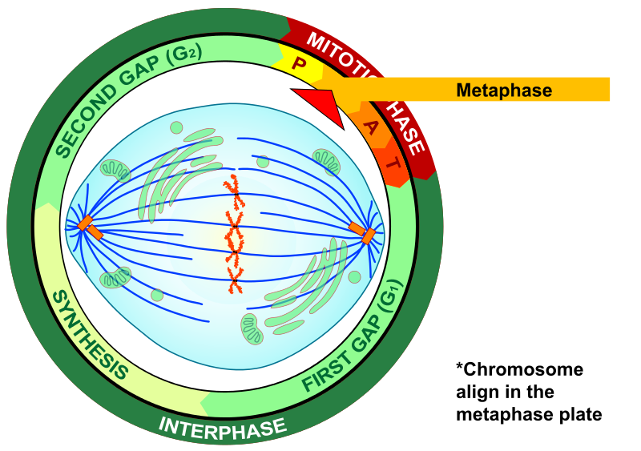
Metaphase of Mitosis

Slide 17
Anaphase of Mitosis
Once the chromosomes align at the metaphase plate, the centriole pairs begin to constrict the spindle fibres (much like a fishing reel), separating the homologous chromosomes.
Once separated, these structures are called daughter chromosomes.
Daughter chromosomes are identical copies of each other.

Slide 18
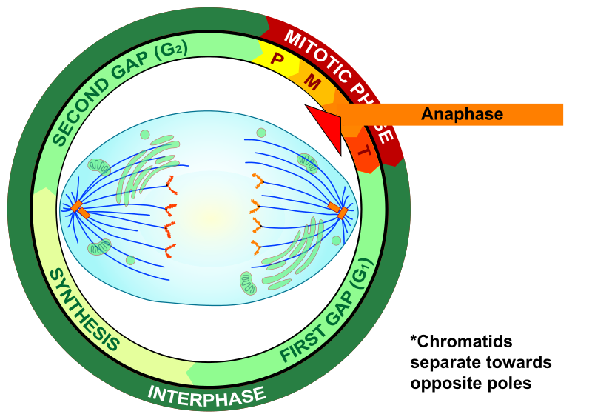
Anaphase of Mitosis

Slide 19
Telophase of Mitosis
During telophase, the spindle fibres disappear.
Once the daughter chromosomes arrive at the poles, a nuclear envelope reappears around each set of chromosomes.
At the end of telophase, there are two nuclei in one cell, known as daughter nuclei, each containing an exact copy of chromosomes.

Slide 20
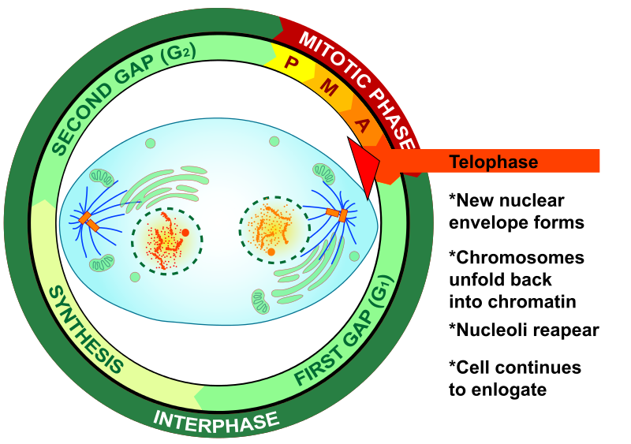
Telophase of Mitosis

Slide 21
Cytokinesis
After the nuclear envelope re-emerges, the chromosomes relax and the remainder of the cytoplasm undergoes division in a process known as cytokinesis.
In animal cells, the cleavage furrow emerges because a row of actin filaments emerge just inside the cell membrane, constricting the cell membrane in on itself.
In plants, vesicles secreted from the Golgi apparatus fuse in the equator of the cell forming the cell plate.
This structure adds cell wall material between the two daughter cells.
This plate continues to grow until it comes in contact with the existing cell membrane of the daughter cell in which it merges, and the cells separate.

Slide 22
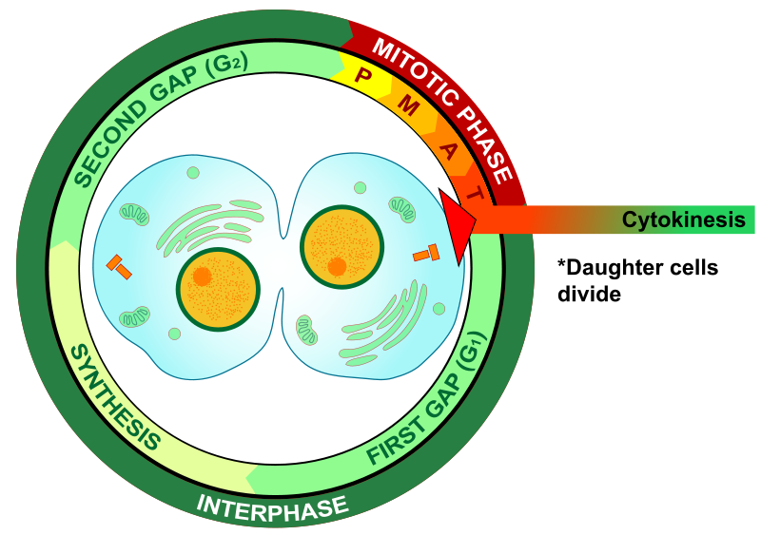
Cytokinesis

Slide 23
Meiosis
Like mitosis, meiosis is a process of nuclear division.
However, where mitosis leads to an exact copy of the chromosomes, meiosis results in producing new cells with exactly half the DNA as the parent cell.
Meiosis is how gametes (sperm and eggs) of organisms are created.
From a single cell, meiosis produces 4 daughter cells, each with half of the DNA of its parental cell.
However, each has a different combination of chromosomes.
Following meiosis, sex cells from different organisms merge creating recombined, genetically unique offspring every generation.
This leads to an increase in diversity of the gene pool, which has evolved as an effective strategy to be adaptive in our ever-changing world.

Slide 24
Chromosomes role in sexual reproduction
Humans have 46 chromosomes, 23 come from your mother and 23 come from your father.
Of the 23 unique chromosomes you got from each parent, each one pairs up precisely with its partner from your other parent during fertilization.
This pairing is called a homologous pair.
Whenever fertilization happens, meiosis cells become diploid.
This means there are two sets of the same chromosomes. This is expressed by the term 2n.
And since we get 23 sets of chromosome from each parent, humans have 46 total chromosomes.
This is notated as 2n=46.
Therefore most cells in your body have 46 chromosomes in 23 homologous pairs, one chromosome from your mother (maternal chromosome) and one from your father (paternal chromosome).

Slide 25
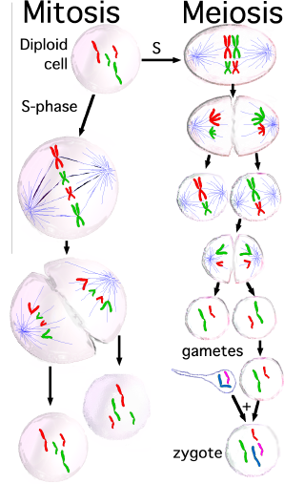

Slide 26
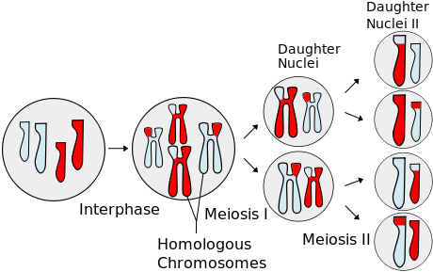
Simplified overview of Meiosis

Slide 27
Interphase preceding Meiosis
During interphase before meiosis begins, chromosomes duplicate and produce sister chromatids of each chromosome.
Prior to the S phase, each homologous pair of chromosomes (one paternal and one maternal chromosome of the same type) are un-replicated. These are known as unreplicated chromosomes.
During the S phase, the unreplicated chromosomes replicate. The replicated strands are called sister chromatids, which are identical copies of each other connected at the centromere.
Each homologous pair of chromosomes has two pairs of sister chromatids. Each pair of connected sister chromatids are called chromosomes: one maternal chromosome (with two sister chromatids) and one paternal chromosome (also with two sister chromatids).
Furthermore, chromatids from a maternal chromosome are said to be non-sister chromatids to the homologous paternal chromosome.

Slide 28
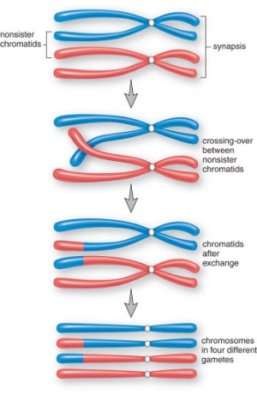
Early Prophase I of Meiosis
Much like mitosis, Early Prophase I of meiosis begins with chromosomes condensing and the nuclear envelope beginning to disintegrate.
Unlike prophase of mitosis, homologous chromosome pairs (i.e. maternal and paternal chromosome pairs) come together forming a tetrad, in which the four chromatids are connected along the length of each chromatid.
Chromatids from different homologous pairs are referred to as non-sister chromatids.

Slide 29
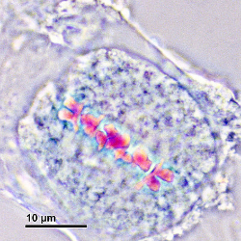
Late Prophase I of Meiosis
In late prophase I, the nuclear envelope completely breaks down and the spindle fibres attach at the kinetochores of the tetrads.
Non-sister chromatids begin separating along several points along their length.
Places where they stay connected are known as chiasmata.
Chiasmata are where DNA was broken and re-joined between adjacent non-sister chromatids of homologous pairs.
These chromosome segment exchanges are known as crossing over.

Slide 30
Metaphase I of Meiosis
In Metaphase I, all of the tetrads align along the metaphase plate. At this point, crossing over has completed,
The chromosomes are referred to as recombinant chromosomes.

Slide 31
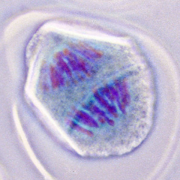
Anaphase I of Meiosis
In Anaphase I, the tetrads are separated and pulled toward opposite poles. At this point the recombinant chromosomes are haploid.

Slide 32
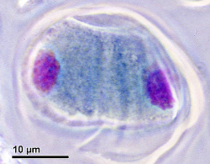
Telophase I and Cytokinesis I of Meiosis
In Telophase I, the nuclear envelope reappears around each group of recombinant chromosomes,
During Cytokinesis I the cytoplasm divides.

Slide 33
Meiosis II
Meiosis II
In Meiosis I, chromosomes recombine in Metaphase I and become haploid in Anaphase I.
During Meiosis II, the main purpose is to split the recombinant chromosomes from each other.
Prophase II through Cytokinesis II is very similar to mitosis with recombinant chromosomes in place of sister chromatids.

Slide 34
